Slide 1
Lecture-6
Generating Random Numbers According to Distributions
Md. Fazlul Karim Patwary
Professor
Institute of Information Technology Jahangirnagar University

Slide 2
Random Number Generation
U(0, 1) distribution plays a prominent role in simulation
Random variables generated from the U(0, 1) distribution are called random numbers which are called independently and identicaly distributed (IID)
The random variables from all other distributions can be obtained by transforming IID random numbers in a way determined by the desired distribution
What is a truly random number / sequence? totally unpredictable
Appear to be distributed uniformly on [0, 1] and independent
Fast, low memory

Slide 3
Linear Congruential Generators (LCG)
The most popular generator
starts with a seed (starting point) Z₀ (integer)
generate the random number stream using recursive formula
Z_{n} = (a Z_{n-1} + c) (mod m)
U_{n} = (double) Z_{n} / m, where 0< U_{n} < 1
a: multiplier
m: modulus
c: increment
Z_{n}: remainder, integers
0≤ Z_{n}< m, 0 ≤ U_{n} <1

Slide 4
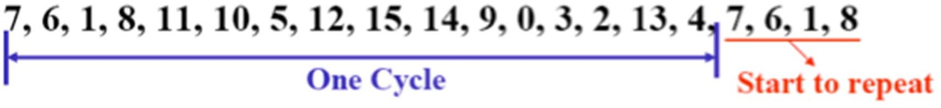
Example
m = 16, a = 5, c = 3, Z₀ = 7
so formula is Z_{i} = (5Z_{i-1} + 3) (mod 16)
The sequence Z_{i} is
When i≥17, the sequence starts to repeat
The “looping” behavior of LCG is inevitable
The length of a cycle is called the period of a generator
The period is at most m
If the LCG is full period, the choice of seed is unimportant. In the example any seed between 0 to 15 can produce the entire cycle

Slide 5
Period of LCG
It is desirable to have LCGs with long periods
It is preferred to have full-period LCGs
Ensure that every integer between 0 and m-1 occur exactly once in each cycle, which could contribute to the uniformity of the U_{n}’s
In general, cycle length determined by parameters m, a, and c

Slide 6
Full Period Theorem
The LCG Z_{i} = (aZ_{i-1} + c) (mod m) has full period (m) if and only all three of the following hold:
c and m are relatively prime (i.e., the only positive integer that divides both c and m is 1).
If q is any prime number that divides m, then q also divides a - 1.
If 4 divides m, then 4 also divides a - 1.
In the previous example m = 16, a = 5, c = 3, which satisfy the three conditions

Slide 7
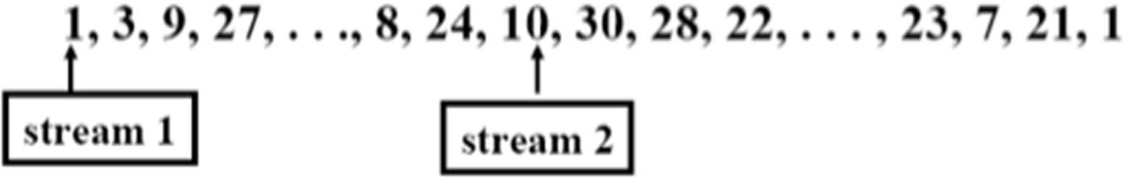
Desired Properties of LCG
Be able to obtain a full period
Reproducible
Using the same seed and generator always produces the same sequence
Fast and low storage
Simple calculation
Multiple streams
Restart in the middle of a sequence by saving the final Z_{i}
obtained previously and use it as the new seed
Obtain non-overlapping, “independent” sequences of random numbers

Slide 8
Multiplicative LCG
A special case of LCG: c = 0
Easier implementation: Z_{n}= a Z_{n-1} (mod m)
Addition of c is not needed
Cannot have full period
c and m are not relatively prime
It is possible to obtain period m-1
The majority of LCGs in use today are multiplicative LCG

Slide 9
Integer Overflow
Choose m = 2^{b}, where b is the number of bits in a word on the computer that are available for actual data storage (e.g., b=31)
The explicit division by m can be avoided by taking advantage of integer overflow
For example b = 4, and m = 16, Z_{i} = (5Z_{i-1} + 3) (mod 16)
if Z_{i-1} = 5, then Z_{i} = 28 (mod 16) = 12
28 = 11100 in binary
4-bit computer can store only rightmost 4 bits, or 1100 = 12
Thus, division modulo 2^{b} is automatic via integer overflow

Slide 10
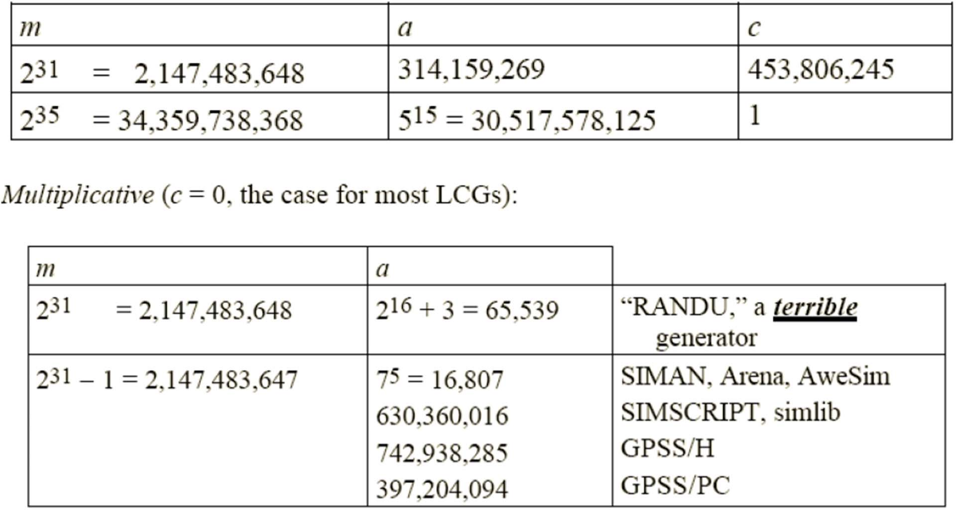
Some “Good” LCGs

Slide 11
Testing Random Number Generators
Since RNGs are deterministic, we need to test whether the U_{i}’s generated are IID and uniformly distributed within 0 and 1
Uniform test
To check whether the U_{i}’s are uniformly distributed between 0 and 1
Minimum requirement of a random number generator
Correlation test
To check the correlation between the random numbers in a sequence

Slide 12
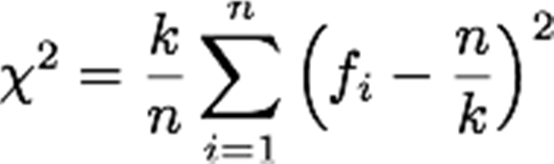
Uniform Test
Chi-Square Test
generate U₁, …, U_{n} from the generator G
H₀: G generates U[0,1]
divide [0, 1] into k intervals
f_{i} = number of U_{j} that fall within the j-th interval
If H₀ is true, χ2 should follow chi-square distribution
H₀ is rejected if χ2 > χ2_{k-1,1-α}

Slide 13
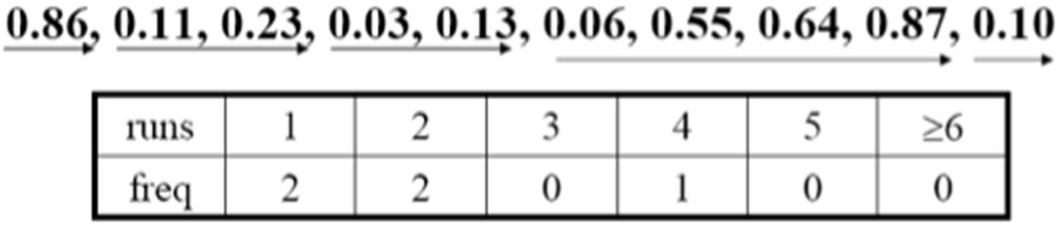
Correlation Test
Runs Up Test
Examine the U_{i} (or Z_{i}) sequence for unbroken subsequences of maximal length within which the U_{i}’s increase monotonically
“Run up of length i” occurs if exactly i U’s in a row go up
E.g., a sequence
The frequency should follow certain distributions

Slide 14
Random Variable Generator
From a uniform distribution U(0,1), how to generate other distributions?
Inverse transform method
Acceptance/Rejection method
Composition method
Convolution method

Slide 15
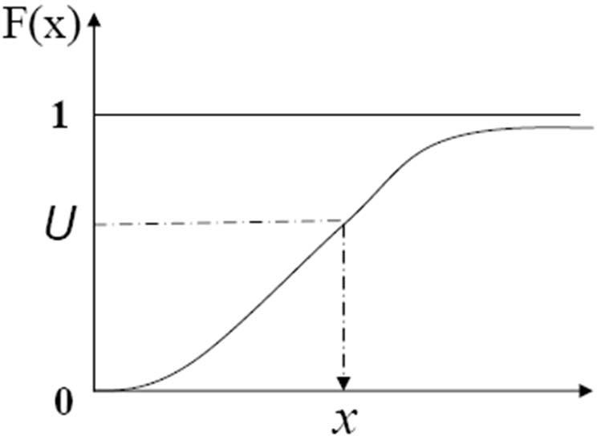
Inverse Transform
We wish to generate a continuous random variable x that has a cumulative distribution function F(x) (note that 0 ≤ F(x) ≤ 1)
The inverse transform algorithm for generating a random variable x having distribution function F is as follows:
Generate a uniform-distributed variable U ~ U(0, 1)
Return x= F⁻¹(U) (F⁻¹ denotes the inverse function of F)
F⁻¹(U) is always defined since U has the same range of F

Slide 16
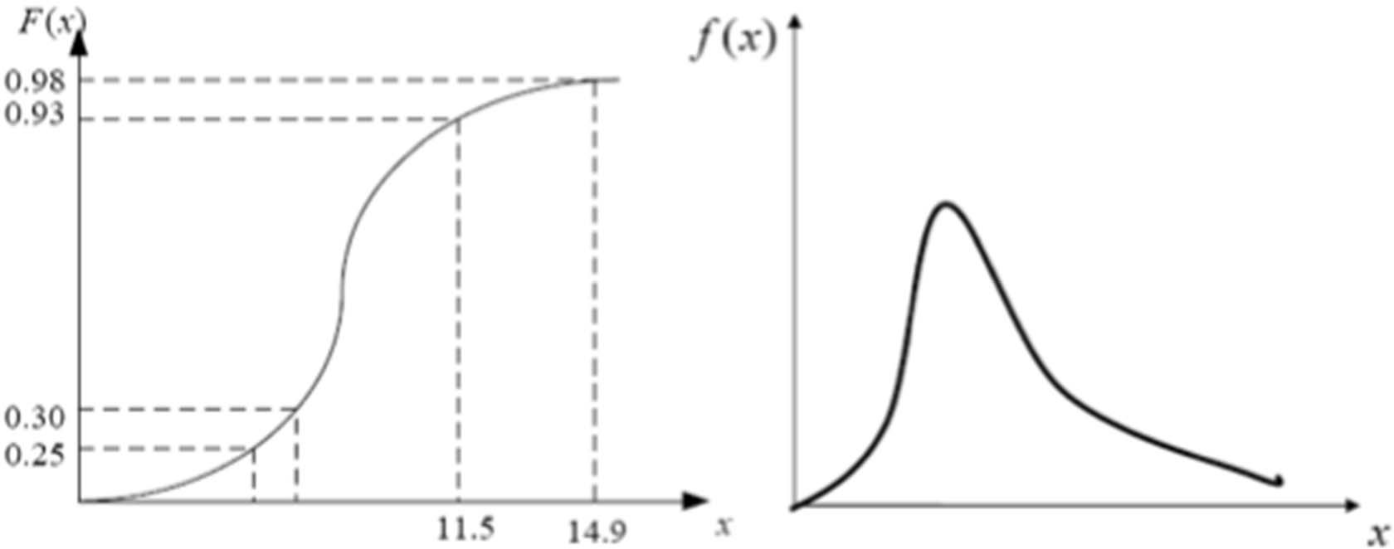
Inverse Transform
To prove the random variable generated by the inverse transform method has the desired distribution F, we must show that for any real number x, P(X ≤ x) =F(x):
P(X ≤ x) = P(F⁻¹(U) ≤ x) = P(U ≤ F(x)) = F(x)

Slide 17
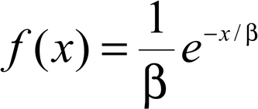

Example
To generate exponential distribution
Algorithm
1. Generate a random number U from U(0,1)
2. F(x) = U = 1−e^{−x/β}
→ x = − βln(1-U)

Slide 18
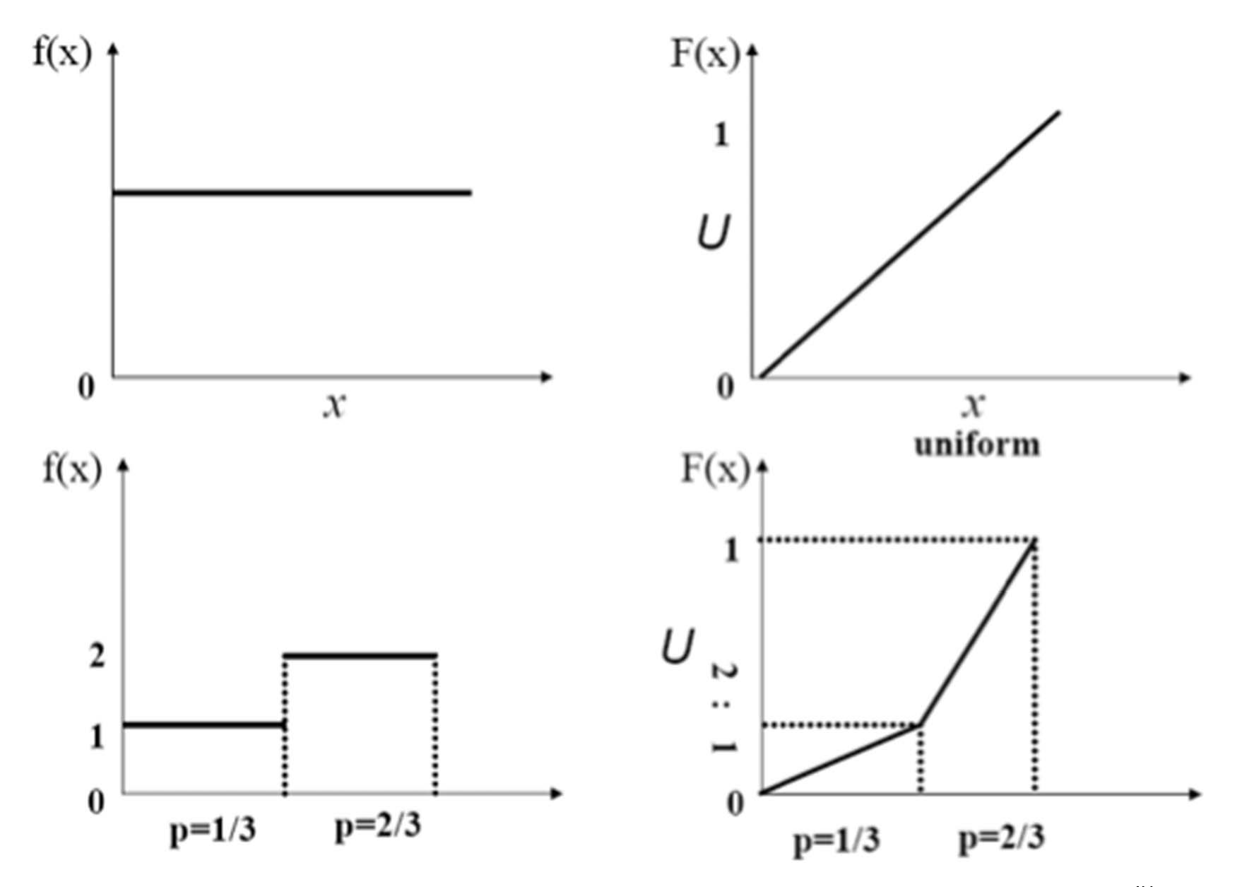
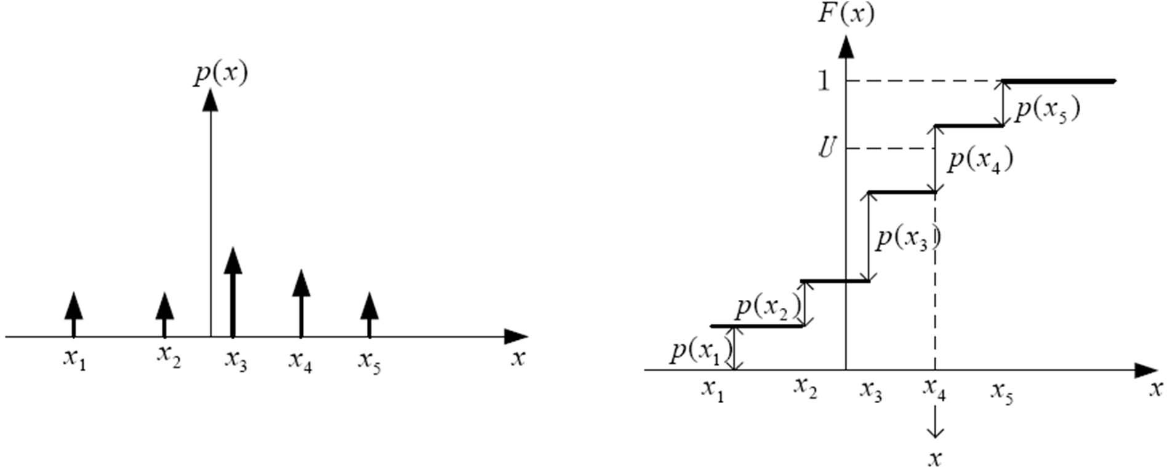
Inverse Transform for Discrete Variables
For discrete variables,, we have
F(x₁)=p(x₁),F(x₂)=p(x₂)+F(x₁), ……
Since U~U(0, 1), P(F(x_{i-1}) < U ≤ F(x_{i})) = p(x_{i})
Therefore, we set x=x_{i} if and only if F(x_{i-1}) < U ≤ F(x_{i})

Slide 19
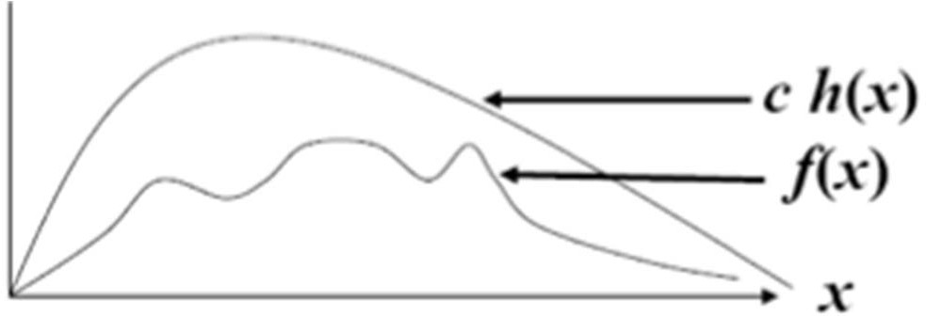
Problems with the inverse transform method
Sometimes, closed form distribution function is not available (e.g. normal, log-normal, beta…)
Calculating the inverse function of F is impossible
f(x) is the distribution we want to generate, but the inverse of its distribution function is not available
h(x) is another distribution that is easy to generate but c h(x) majorizes the density function f(x), where c is a scalar. That is ch(x) ≥ f (x) for all values of x

Slide 20
Acceptance/Rejection Method
A motivating example
We want to generate a random variable X~U(1/4,1)
Follow three iterative steps:
Generate a random number R~U(0,1)
If R≥1/4, accept X=R, then go to Step 3.
If R<1/4, reject R, and return to Step 1.
If another uniform random variable on [1/4,1] is needed, repeat from Step 1. If not, stop

Slide 21
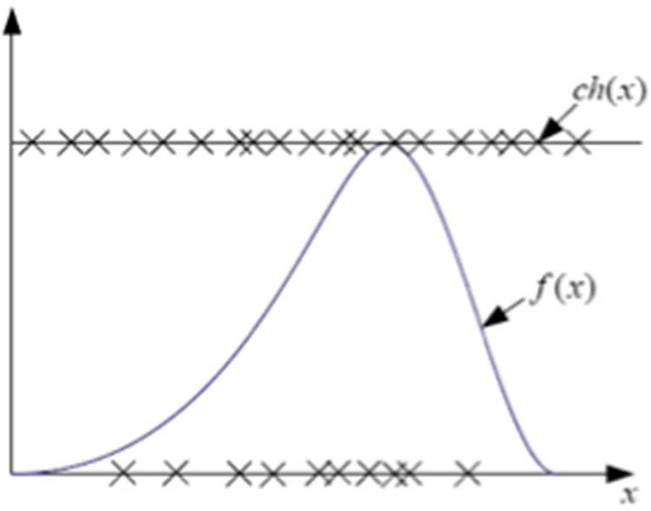
Acceptance/Rejection Method
Although we cannot generate f(x) directly, we can generate h(x) instead
General algorithm
Generate a random variable x having density h(x)
Generate a uniform distributed variable U~U(0, 1) independent of x
If U ≤ f(x)/ch(x), then x is accepted as the generated output with density function f(x)
Otherwise, x is rejected and the procedure is repeated again

Slide 22
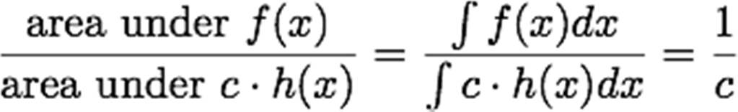
Acceptance/Rejection Method
Probability that x is accepted
Requirements of the method
Efficient: to maximize the acceptance probability
c should be small
Easy to generate h(x)
Simplest one is uniform distribution
c might not be as small as we want

Slide 23
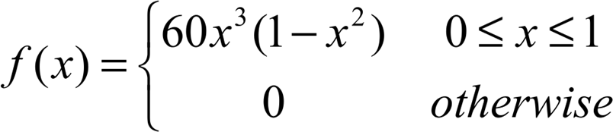
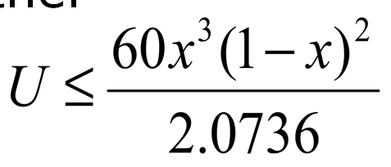
Example
Generate a random variable with beta(4,3) distribution on the unit interval
Let h(x)=U(0, 1). Since the maximum value of f(x) occurs at x=0.6, where f(0.6)=2.0736. Therefore, we let c=2.0376
The algorithm first generate x and U as i.i.d. U(0, 1) random variables.
Then we check whether
if yes, x is accepted as the generated random variable with beta(4, 3) distribution.
Otherwise, we reject x and repeat the whole procedure

Slide 24
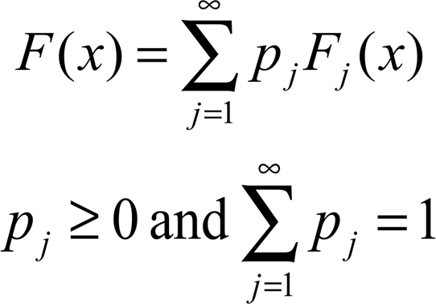
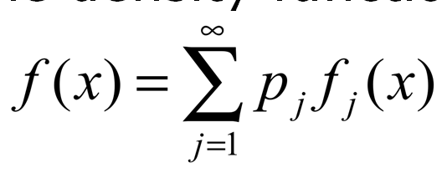
Composition Method
Composition technique applies when the distribution function F from which we wish to generate can be expressed as the convex combination of other distributions F1, F2, ……
This method applies when F(x) can be written as
equivalently, the density function can be written as
Note that although the combination is written as an infinite sum, there may be a k such that p_{j}=0 for all j>k

Slide 25
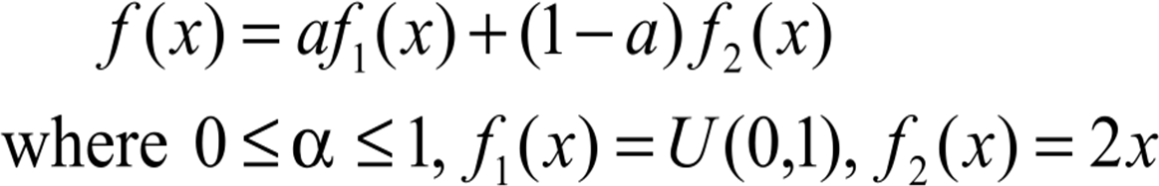


Composition Method
Step 1: Generate a positive random integer J such that P(J=j)=p_{j} for j=1, 2, …
Step 2: Generate a random variable x with distribution function F_{j}
It can be proved that x has a distribution function F
Generate a random variable with the probability density function
Generate y~U(0, 1)
If y≤a, then generate x~U(0, 1).
Otherwise, generate z~U(0, 1), and let since
x is the variable with desired density function

Slide 26
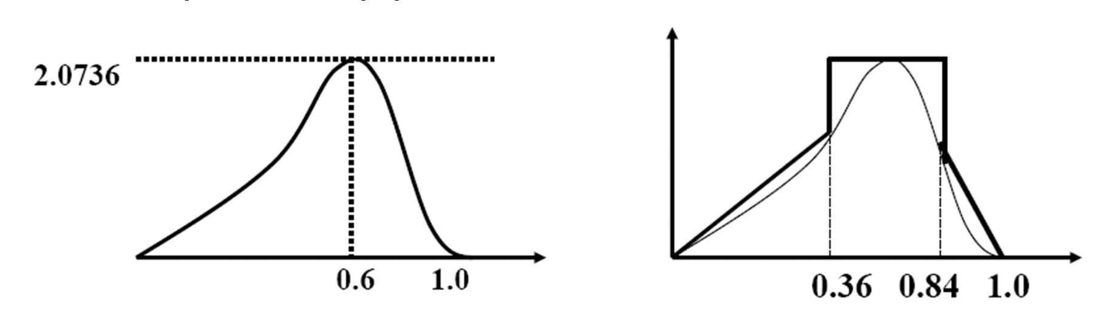
Example
Beta(4,3) revisit
Instead of selecting a uniform function to bound f(x)
The probability of acceptance is the ratio between the area below f(x) and the area below ch(x)
We would like to have an efficient algorithm, i.e., the acceptance ratio is high. In other words, we want ch(x) to fit closely above f(x)

Slide 27
Example
The beta(4, 3) function has two points of inflection (f’’(x)=0) at x=0.36 and x=0.84
Therefore, we can divide f(x) into three regions
We can find a piecewise linear function h(x) such that ch(x)≥f(x) for all x.
The method is more efficient since the probability of acceptance a variable is increased.
A combination of three methods
The distribution of h(x) can be generated by the composition method
Each region is generated by the inverse method
Final generation of the random variable is decided by the acceptance/rejection method

Slide 28
Convolution Method
For some distributions, the desired random variable x can be expressed as a sum of other random variables
x = y₁+y₂+…y_{m}
Recall that the distribution of x is the convolution of the distribution of y₁, y₂, …, y_{m}
Algorithm
Generate y₁, y₂, … y_{m}
Return x = y₁+y₂+…y_{m}

Slide 29

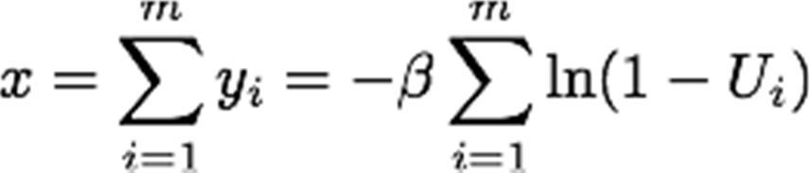
Example
Erlang Distribution
where y follows an exponential distribution
Generate y by the inverse method
where U ~U(0,1)
Then we have

